Slide 1
PROJECT TITLE
CAPSTONE PROJECT
Presented By:
G sai sruthi
NRI INSTITUTE OF TECHNOLOGY
CSE

Slide 2
OUTLINE
Problem Statement
Technology used
Wow factor
End users
Result
Conclusion
Git-hub Link
Future scope

Slide 3
Problem Statement
"The objective is to design and implement a secure steganographic technique that enables the efficient and undetectable embedding of arbitrary data within digital images, while maintaining image quality and resisting advanced steganalysis methods."
"This project aims to develop a steganographic solution that addresses the limitations of existing methods, specifically by improving data capacity, imperceptibility, and robustness against common image manipulations and steganalysis attacks."

Slide 4
Technology used
Libraries:
OS: file and directory manipulation, environmental variable access and process management.
OpenCV(open source computer vision): provides extensive capabilities for image and video processing.
Pillow (PIL): A Python Imaging Library that provides easy-to-use methods for opening, manipulating, and saving imag flies
Platforms:
IDLE(Integrated Development & Learning Environment):IDLE provides an interactive Python shell (REPL) where users can execute Python commands and see the results immediately. This is useful for testing small snippets of code quickly.
OpenStego: An open-source tool for steganography, allowing users to hide data in images.

Slide 5
Wow factors
1. The Illusion of Invisibility:
Concealed in Plain Sight:
The core "wow" is the ability to hide information so effectively that it goes completely unnoticed. This challenges our perception of what's visible and what's hidden.
The idea that a seemingly ordinary image can hold a secret message is inherently fascinating.
Subverting Expectations:
Unlike cryptography, which signals the presence of a secret, steganography aims to eliminate suspicion altogether. This element of deception is a powerful concept.
2. The Power of Discreet Communication:
Covert Channels:
Steganography enables secure communication in environments where traditional encryption might raise red flags. This has significant implications for privacy, security, and even activism.
The ability to bypass censorship or surveillance by hiding information within everyday media is a powerful idea.
Data Protection:
Beyond simple messaging, steganography can be used for data protection, such as embedding watermarks or verifying the authenticity of digital content.

Slide 6
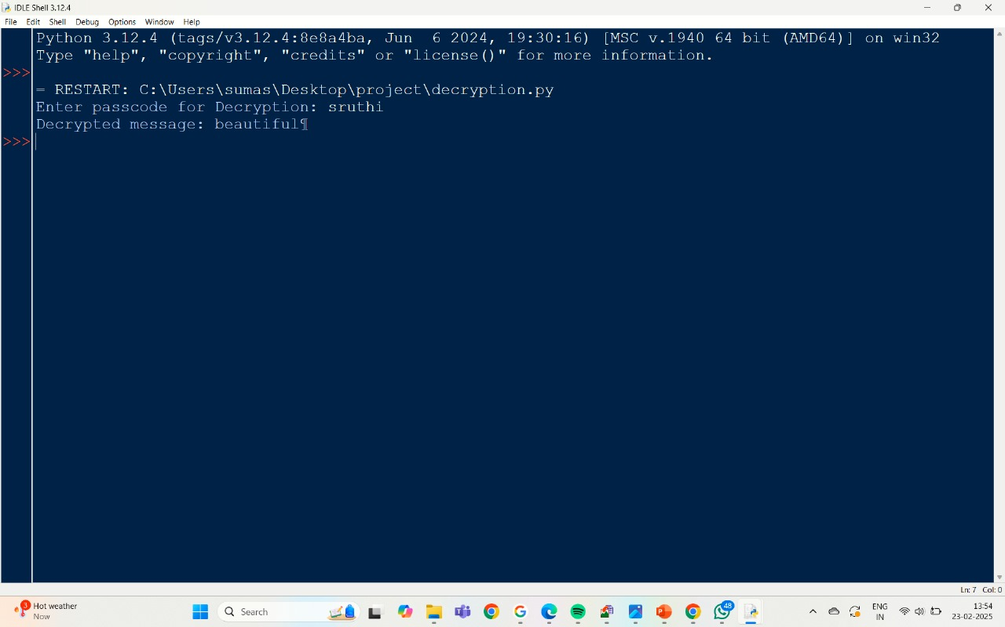
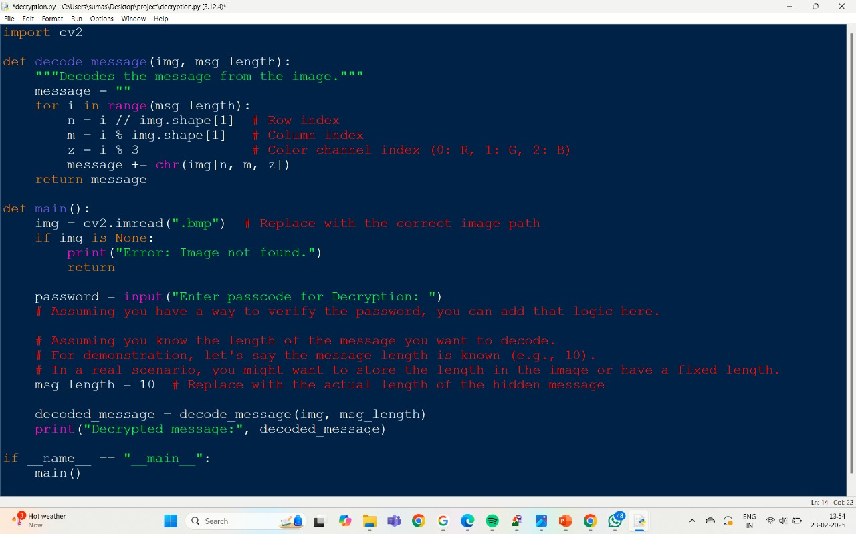
results

Slide 7
End users
Legitimate End-Users:
Individuals concerned with privacy:
People wanting to send sensitive information discreetly, bypassing potential surveillance.
Journalists and activists in countries with censorship.
Security Professionals:
For digital watermarking and authentication of digital media.
In digital forensics, to uncover hidden data in investigations.
For covert communication within secure environments.
Intelligence Agencies and Military:
For secure and covert communication.
For hiding sensitive data within seemingly innocuous files.
Healthcare Professionals:
For securely transmitting patient data within medical images.
Artists and Content Creators:
For embedding digital watermarks to protect intellectual property

Slide 8
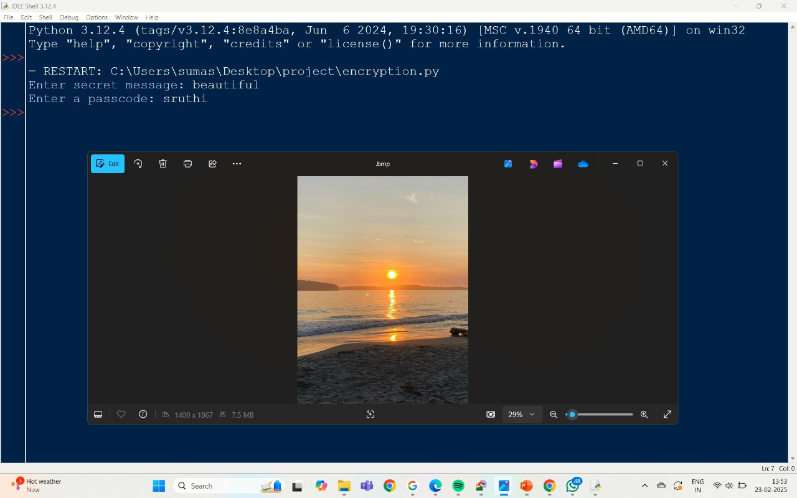
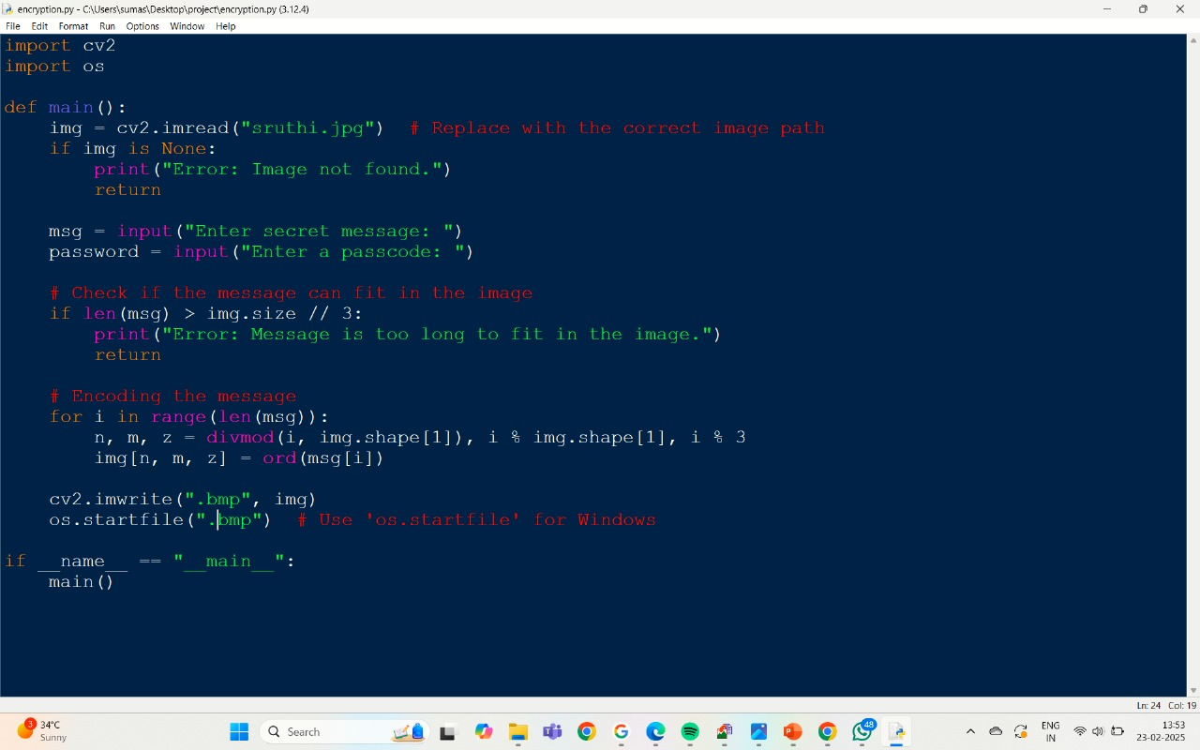
Results
Screenshots of the outcome (min 3)

Slide 9
Conclusion
In conclusion, steganography presents a fascinating and powerful method for concealing information within digital media, particularly images. Its ability to create seemingly invisible channels of communication has captivated both researchers and practitioners. While offering significant potential for secure data transfer and protection, it also poses challenges due to its dual-use nature.
The ongoing advancements in steganographic techniques, coupled with the ever-evolving landscape of steganalysis, highlight the need for continuous research and development in this field. As digital technologies become increasingly integrated into our lives, the importance of safeguarding sensitive information will only grow, making steganography a relevant and crucial area of study.

Slide 10
GitHub Link
https://github.com/Gaminisaisruthi/cybersecurity

Slide 11
Future scope(optional)
1. AI-Driven Steganography and Steganalysis:
Generative Adversarial Networks (GANs): GANs can be used to create highly realistic steganographic images that are extremely difficult to detect. Conversely, GANs can also be employed in steganalysis to identify subtle patterns indicative of hidden data.
Deep Learning for Steganalysis: Deep learning algorithms can be trained to recognize complex steganographic patterns, even those that are undetectable by traditional methods.
Adaptive Steganography: AI can enable steganographic systems to adapt to different image characteristics and steganalysis techniques, making them more resilient.
2. Steganography in Emerging Media:
3D Images and VR/AR Environments: As these technologies become more prevalent, steganography will likely extend to 3D models and virtual environments.
Video Steganography: Video steganography will continue to be a focus, especially with the increasing use of high-resolution video and streaming services.
Network Steganography: Hiding data within network protocols and traffic patterns will become increasingly important for covert communication.
DNA Steganography: The concept of hiding data within DNA sequences is a very interesting area of research, though still in its infancy.
3. Enhanced Security and Robustness:
Quantum-Resistant Steganography: As quantum computing advances, developing steganographic techniques that are resistant to quantum attacks will be essential.
Improved Robustness against Image Manipulation: Steganographic methods will need to become more robust against compression, noise, and other image transformations.
More Secure Key Management: More advanced key management systems will be required to protect the hidden data.
Blockchain Integration: Using blockchain for secure key distribution, and also for verifying the integrity of the steganographic process.

Slide 12
THANK YOU

